Slide 1


BIT07 – Machine Learning
Cedric Hermans

Slide 2
Clustering

Slide 3
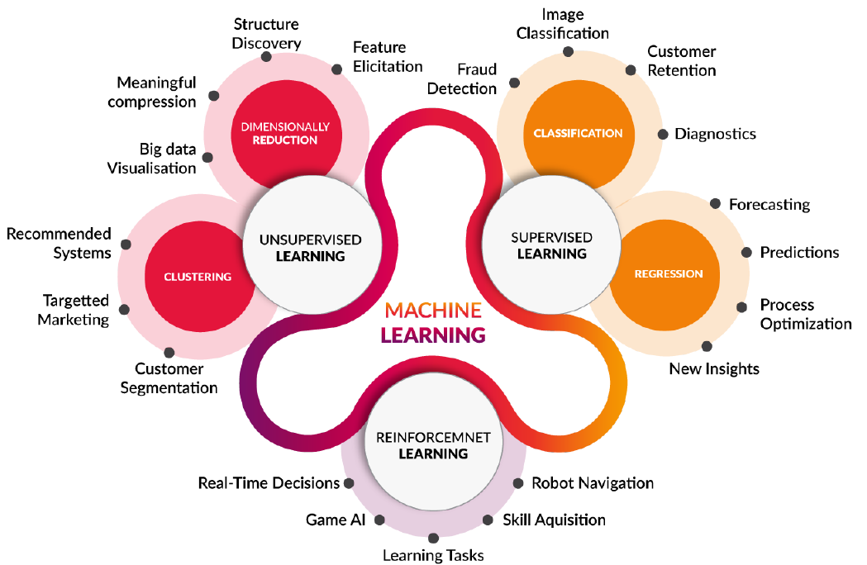
Overview ML

Slide 4
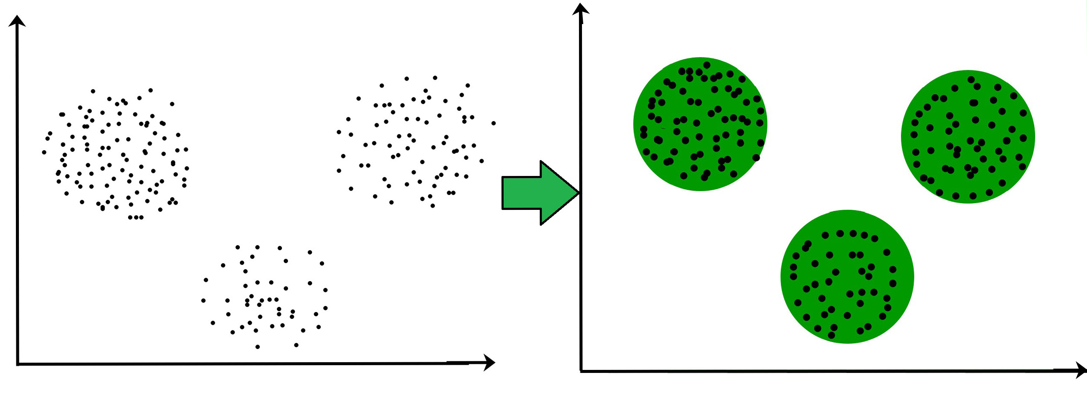
Unsupervised learning
Unlabeled training set
No “correct” answers

Slide 5
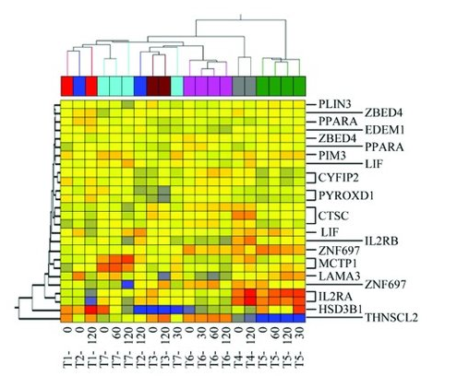
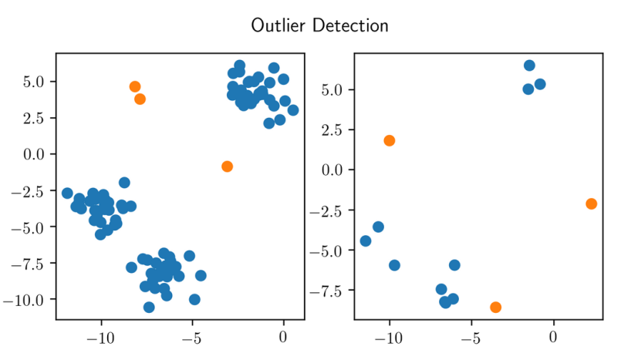
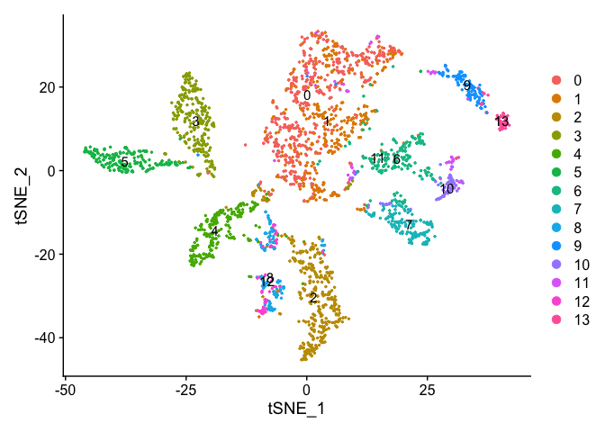
Unsupervised learning
Why?
Find similar data groups (clusters)
Find outliers in data (anomaly detection)
Reduce the amount of data, but keep information (dimensionality reduction)

Slide 6
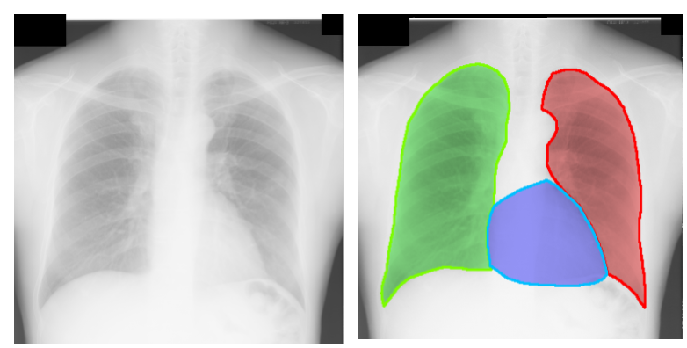
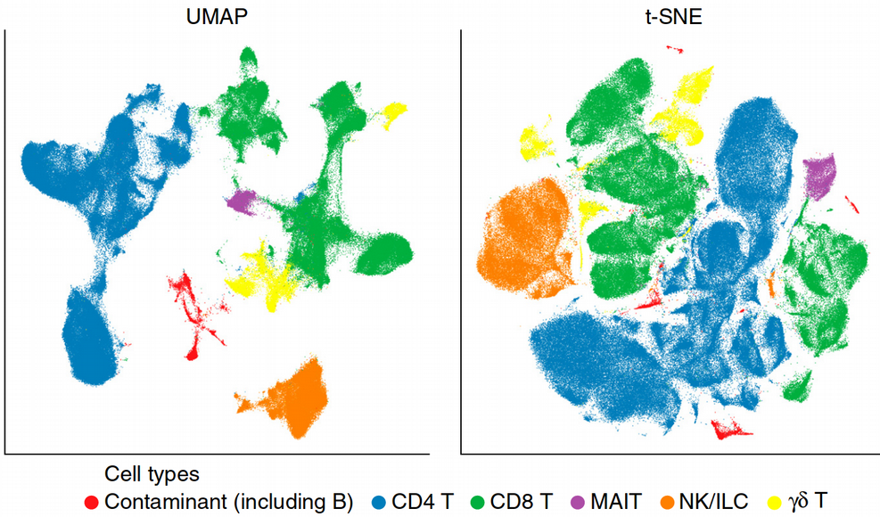
Clustering
Applications
Related search results e.g., Google
Related articles on news sites
Market segmentations
Social media clustering
Image segmentation
Sequence analysis (e.g., homologous gene families, phylogenetic trees)
High throughput genotyping

Slide 7
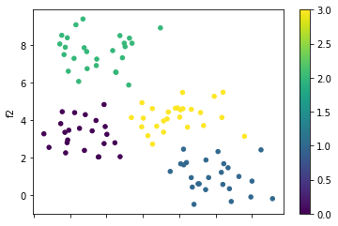
Clustering
Divide data into groups that “fit” together
Different methods
Partitioning Methods
Hierarchical Based Methods
Density-Based Methods
Grid-based Methods

Slide 8
Partitioning Methods
Partition the samples into k clusters and each partition forms one cluster
This method is often using the distance between different samples as a partition criterion
E.g., K-means clustering

Slide 9
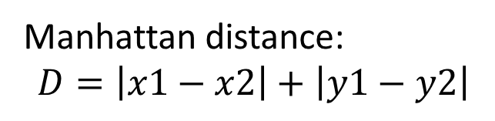
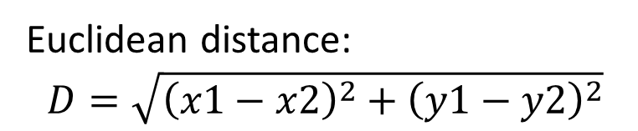
K-means clustering
The algorithm will categorize the items into k groups of similarity
To calculate that similarity, the Euclidean distance is used as measurement.
The algorithm works in three major steps:
Initialization centroids
Categorizing samples
Update centroids
Manhattan distance:
$$D=\left|x1−x2\right|+\left|y1−y2\right|$$
Euclidean distance:
$$D=\sqrt{{\left(x1−x2\right)}^{2}+{\left(y1−y2\right)}^{2}}$$

Slide 10
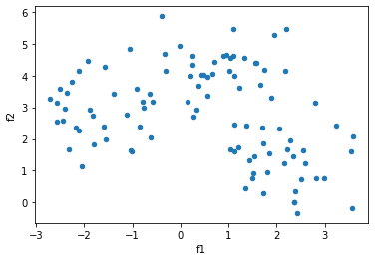
K-means clustering
Initializing centroids
Initialize K random points to be the center of the cluster
Often, three random points from the dataset are chosen as initial values

Slide 11
K-means clustering
Categorize samples
Determine for each sample which is the closest centroid
We do this using the Euclidean distance

Slide 12
K-means clustering
Update centroids
Update centroid location to the mean of all samples assigned to that centroid

Slide 13
K-means clustering
Repeat
Categorize samples

Slide 14
K-means clustering
Repeat
Update centroids

Slide 15
K-means clustering
Repeat
Categorize samples

Slide 16
K-means clustering
Repeat
Update centroids

Slide 17
K-means clustering
Repeat
Categorize samples

Slide 18
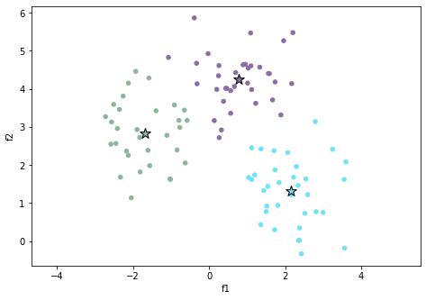
K-means clustering
Result after n iterations

Slide 19
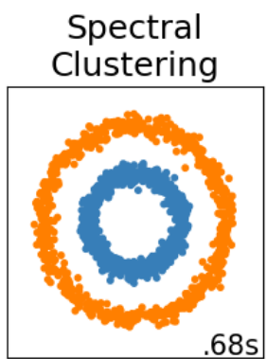
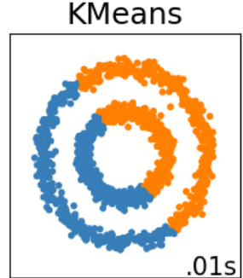
K-means clustering
Characteristics
Easy to use and results are easy interpretable
Sometimes gets stuck at local optima
Final result is dependent on initialized centroids
Try multiple differently initialized models to find the best model (global optima)
Very sensitive to outliers
Problem with not linearly divisible data
Solution: use another clustering algorithm e.g., Spectral clustering
All sklearn algorithms with example images: sklearn clustering

Slide 20
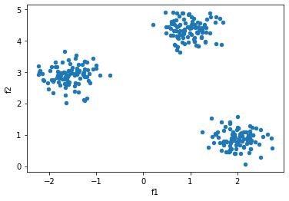
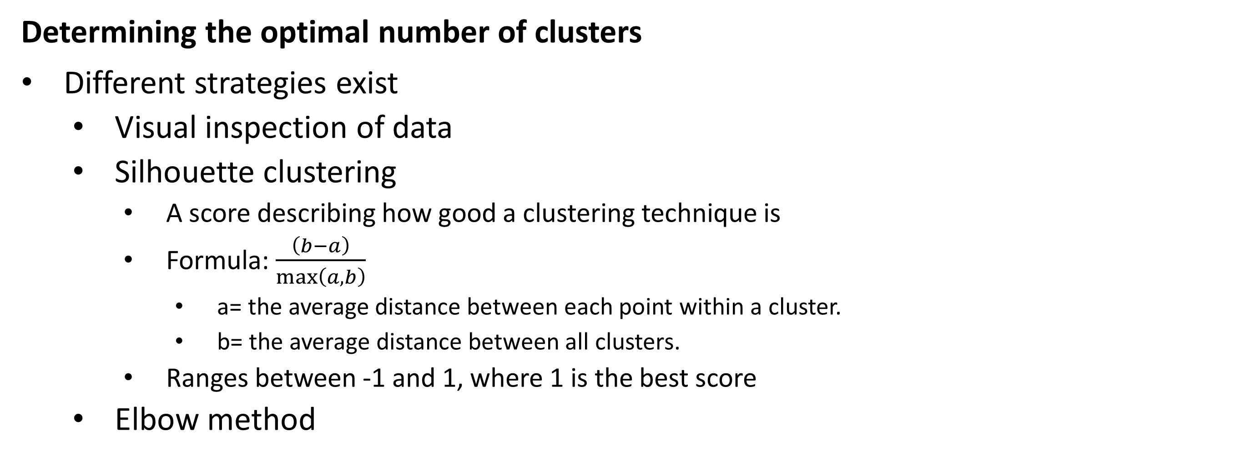
K-means clustering
Determining the optimal number of clusters
Different strategies exist
Visual inspection of data
Silhouette clustering
A score describing how good a clustering technique is
Formula: $\frac{\left(b−a\right)}{\max\left(a,b\right)}$
a= the average distance between each point within a cluster.
b= the average distance between all clusters.
Ranges between -1 and 1, where 1 is the best score
Elbow method

Slide 21
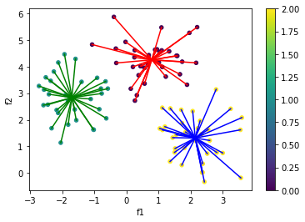
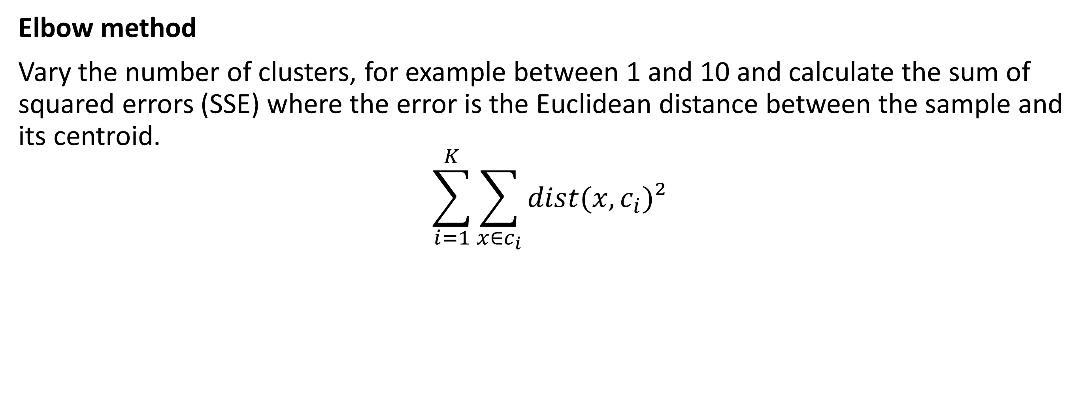
K-means clustering
Elbow method
Vary the number of clusters, for example between 1 and 10 and calculate the sum of squared errors (SSE) where the error is the Euclidean distance between the sample and its centroid.
$$\sum_{i=1}^{K}{\sum_{x∈c_{i}}{dist(x,c_{i}})²}$$

Slide 22
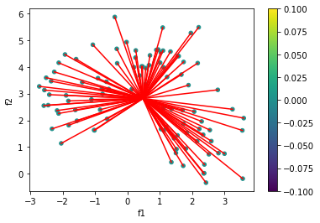
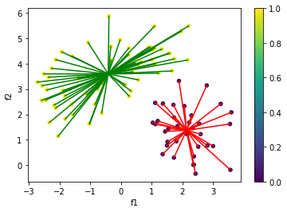
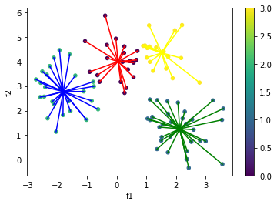
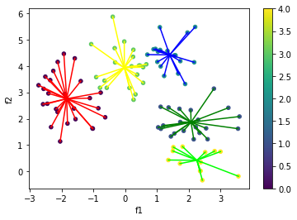
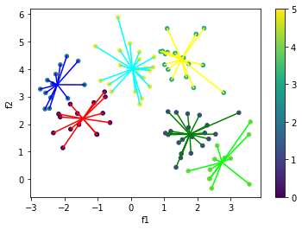
K-means clustering
Elbow method
K=1 SSE: 506
K=2 SSE: 247
K=3 SSE: 113
K=4 SSE: 97
K=5 SSE: 80
K=6 SSE: 65

Slide 23
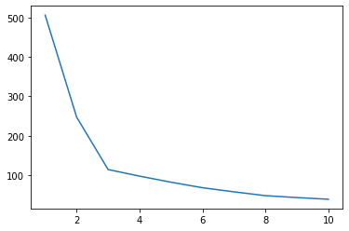
K-means clustering
Elbow method
Plot the SSE values
The “elbow” is the best number of clusters
K=3

Slide 24
Hierarchical clustering
Hierarchical clustering
A general family of clustering algorithms that build nested clusters by merging or splitting them successively
Can be represented as a tree/dendrogram
Root is a cluster that contains all samples
Leaves/terminal nodes are a cluster that contains a single sample

Slide 25
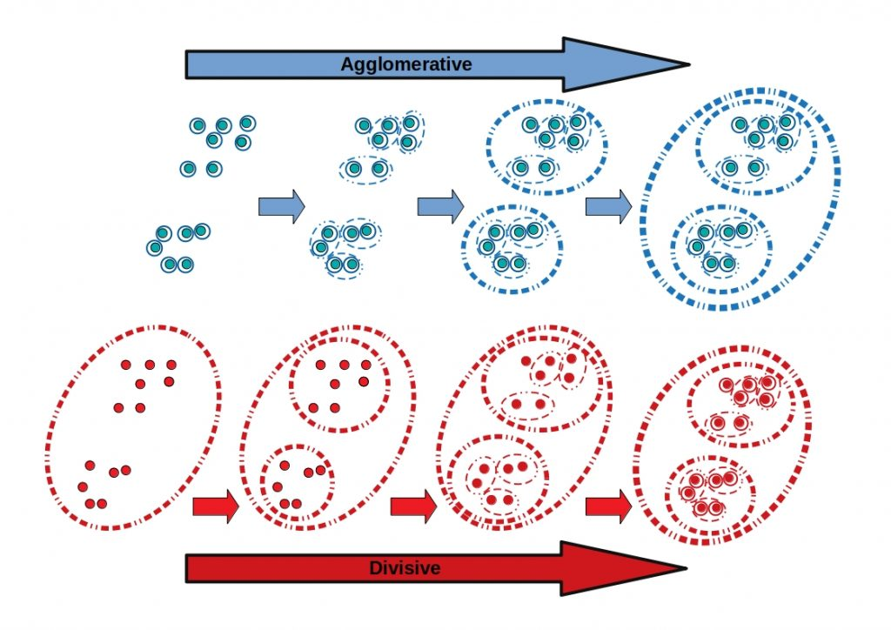
Hierarchical clustering
Hierarchical clustering
Two major types
Agglomerative hierarchical clustering
Combing smaller clusters into larger ones (bottom-up)
Divisive hierarchical clustering
Dividing larger clusters into smaller ones (top-down)

Slide 26
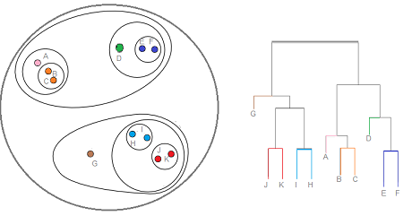
Hierarchical clustering
Hierarchical clustering
Dendrogram representation

Slide 27
Hierarchical clustering
Hierarchical clustering
Advantages:
No need to know the number of clusters in advance -> only split so many times
Structure of tree could be useful (e.g., phylogenetic tree)
K=2
K=3
K=4

Slide 28
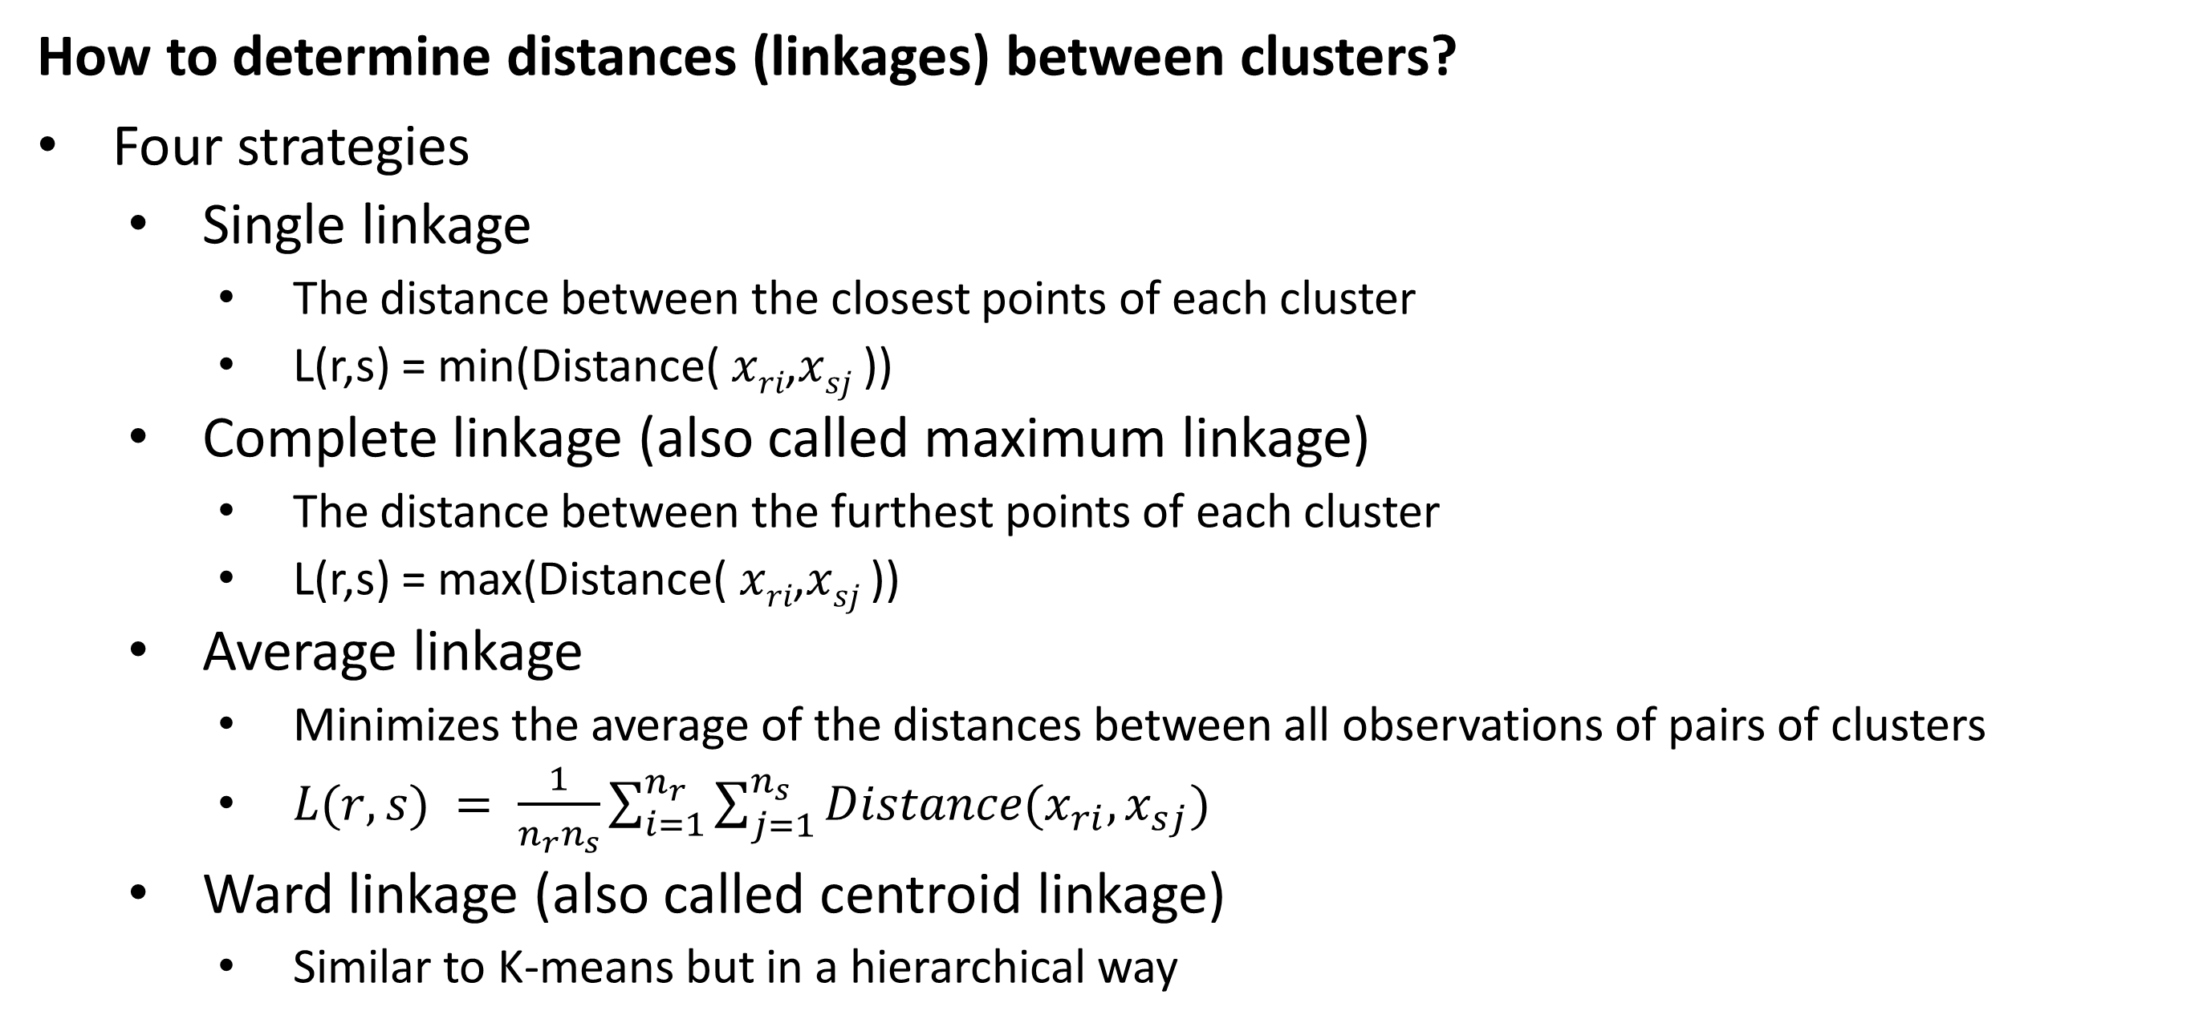
Hierarchical clustering
How to determine distances (linkages) between clusters?
Four strategies
Single linkage
The distance between the closest points of each cluster
L(r,s) = min(Distance( 𝑥_{𝑟𝑖},𝑥_{𝑠𝑗} ))
Complete linkage (also called maximum linkage)
The distance between the furthest points of each cluster
L(r,s) = max(Distance( 𝑥_{𝑟𝑖},𝑥_{𝑠𝑗} ))
Average linkage
Minimizes the average of the distances between all observations of pairs of clusters
$L(r,s) = \frac{1}{n_{r}n_{s}}\sum_{i=1}^{n_{r}}{\sum_{j=1}^{n_{s}}{Distance(x_{ri},x_{sj})}}$
Ward linkage (also called centroid linkage)
Similar to K-means but in a hierarchical way

Slide 29
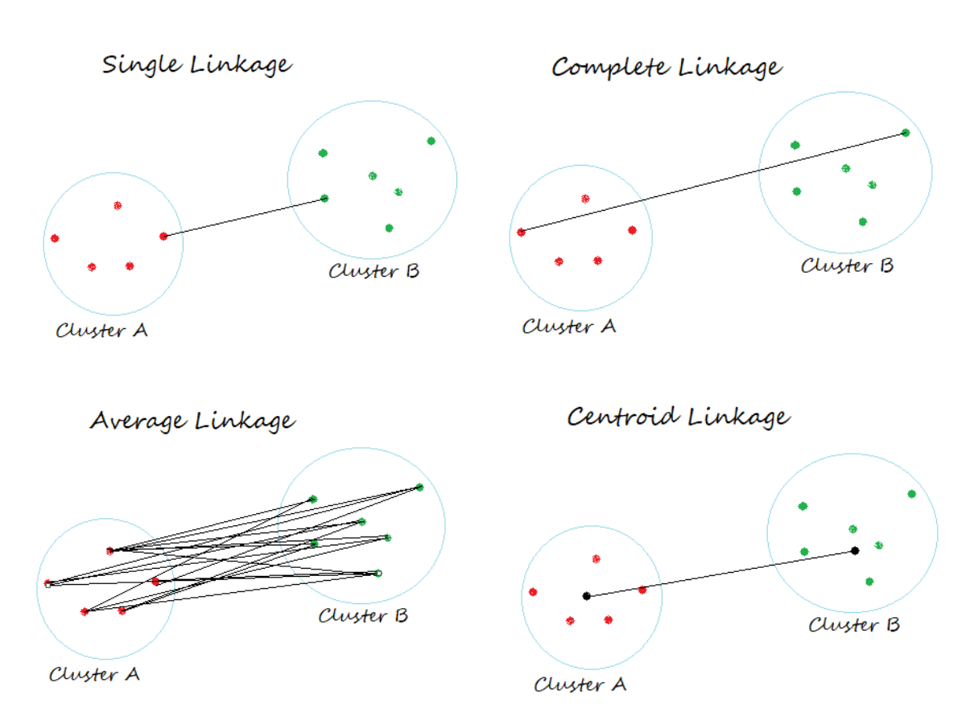
Hierarchical clustering
How to determine distances (linkages) between clusters?

Slide 30
Hierarchical clustering
Complexity
Hierarchical clustering is very computationally intensive
Calculations are at least quadratically dependent on the number of datapoints
Not useable for very big datasets

Slide 31
Dimensionality reduction

Slide 32
Dimensionality reduction
The process of reducing the number of random variables or attributes under consideration.
Applications
Visualizations (not possible with more than 3 features)
Removing noise
Data compression
‘The curse of dimensionality’
Some models do not perform well with a lot of different features

Slide 33
Dimensionality reduction
Algorithms
Principal component analysis (PCA)
Linear Discriminant Analysis (LDA)
Multidimensional scaling (MDS)
Uniform Manifold Approximation and Projection (UMAP)
t-distributed stochastic neighbor embedding (t-SNE)
Autoencoders (special neural network)
Missing values Ratio
Low variance filter

Slide 34
Dimensionality reduction
Practical examples
Classification of genes
Face recognition
Voice recognition
Handwriting recognition
Compression
(outlier detection)

Slide 35
Principal component analysis
PCA transforms a number of features to a smaller amount of non-correlated features, also called principal components, whilst preserving as much information as possible.
PCA determines the eigenvectors based on the data’s covariance matrix that are also scaled and shifted
More details: https://setosa.io/ev/principal-component-analysis/

Slide 36
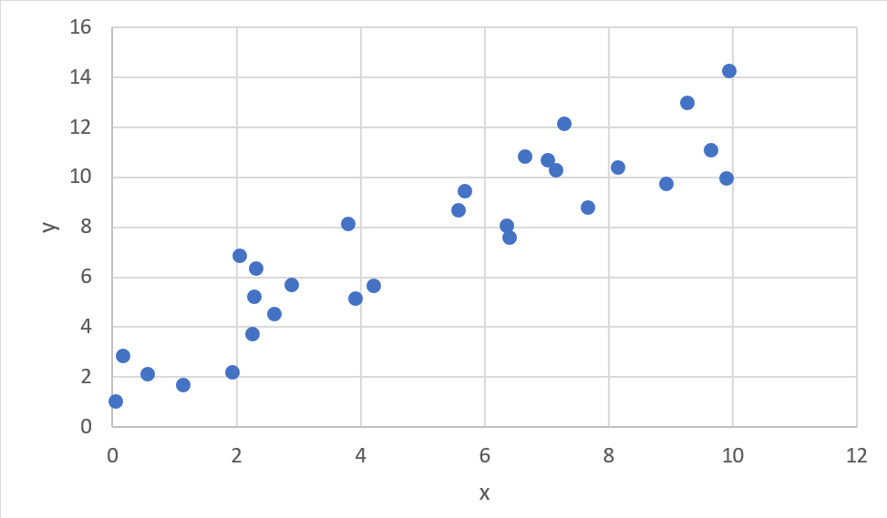
Principal component analysis
Example

Slide 37
Principal component analysis
Example
Determine the axis where there is the most variance

Slide 38
Principal component analysis
Example
This axis becomes principal component 1. The perpendicular axis becomes principal component 2. This can also be scaled up to higher dimensions.
PC2
PC1

Slide 39
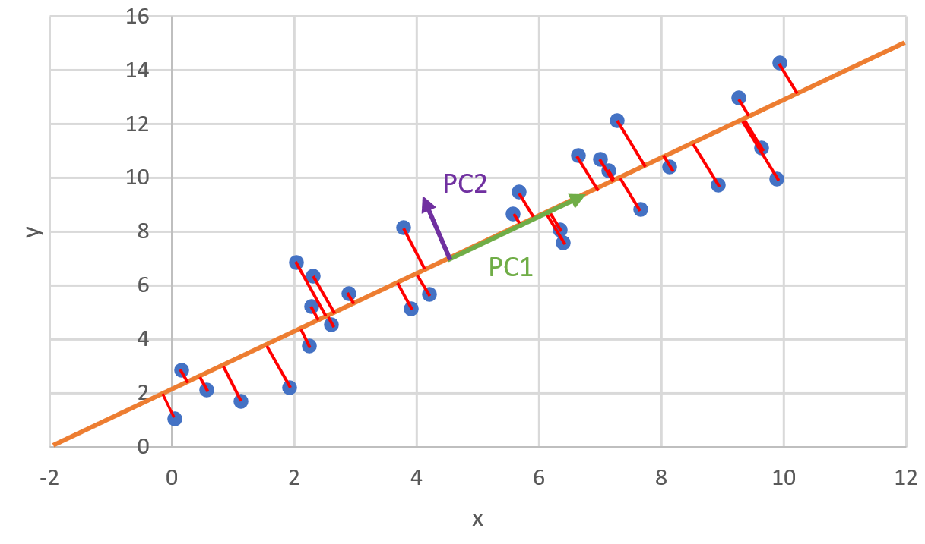
Principal component analysis
Example
The axis is determined based on the smallest SSE.
Note: Linear regression: sum of least squares

Slide 40
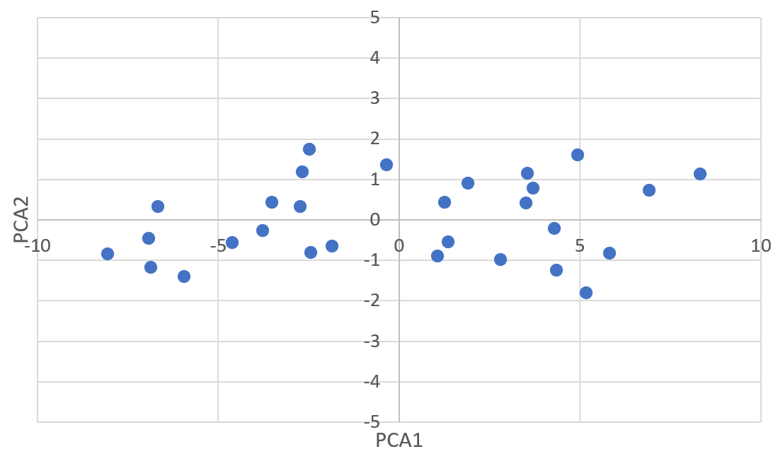
Principal component analysis
Example
Rotate to this axis and scale it so that the points are centered around 0,0

Slide 41
Principal component analysis
Example
Rotate to this axis and scale it so that the points are centered around 0,0

Slide 42
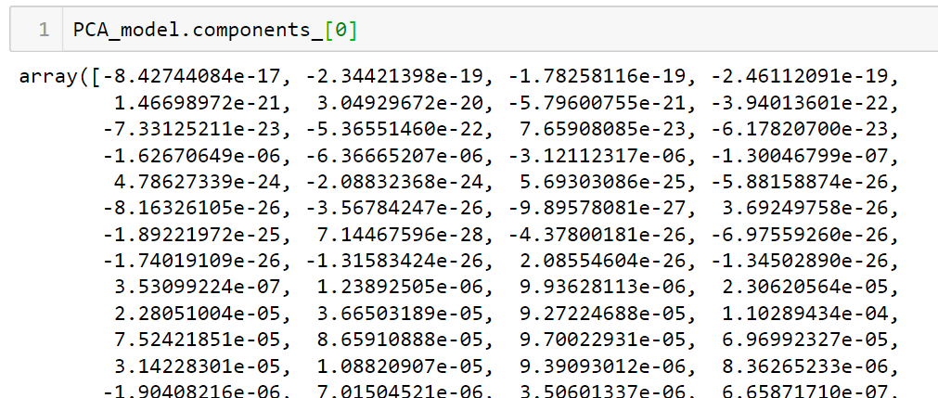
Principal component analysis
Reconstruction of data using PCA
Each principal component is basically a measurement of how much each features should be counted.
E.g., MNIST has 784 pixels => reduce them to 10 components
Each component has 784 values representing how much each pixels is important for the component

Slide 43
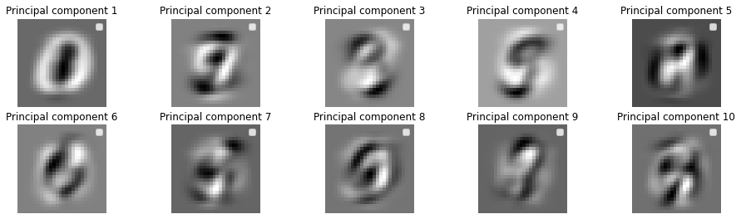
Principal component analysis
Reconstruction of data using PCA
We can also create an image out of these principal component values
This we call “eigendigits” (for face recognition this would be eigenfaces)

Slide 44
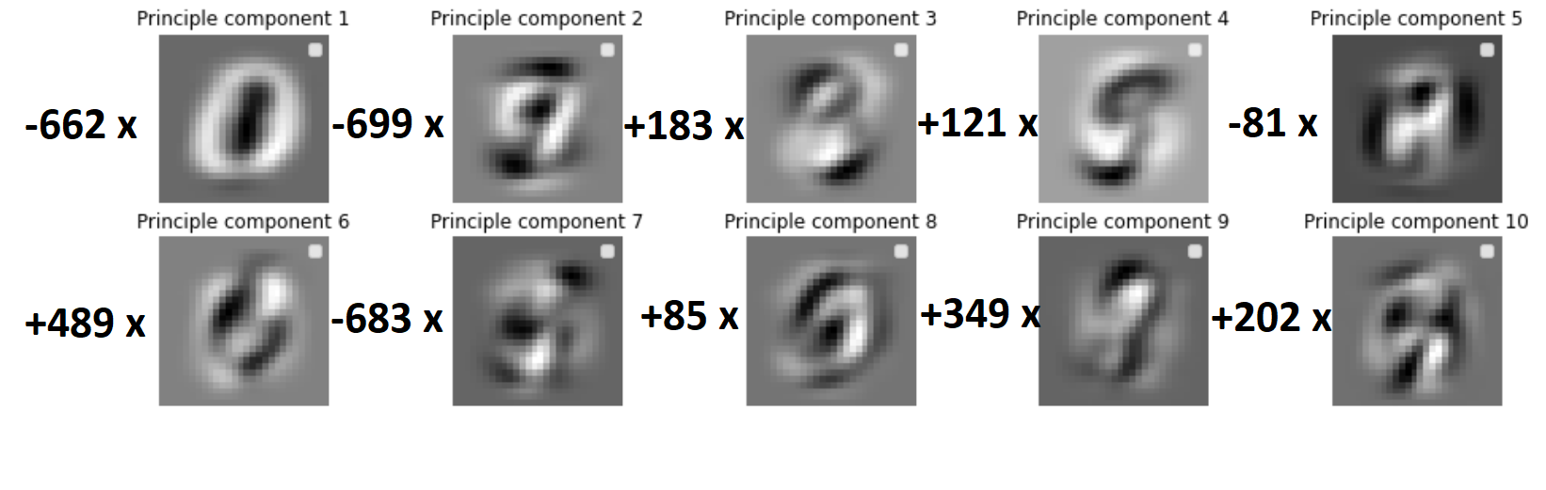
Principal component analysis
Reconstruction of data using PCA
Using the principal components of a specific image, we can reconstruct the original digit.
E.g., PCA_features = [-662, -699, 183, 121, -81, 489, -683, 85, 349, 202]

Slide 45
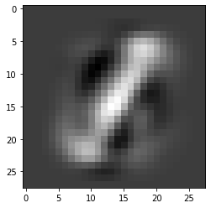
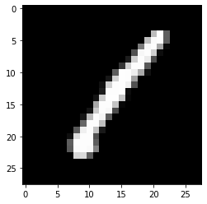
Principal component analysis
Reconstruction of data using PCA
Using the principal components of a specific image, we can reconstruct the original digit.
E.g., PCA_features = [-662, -699, 183, 121, -81, 489, -683, 85, 349, 202]
reconstructed
Original

Slide 46
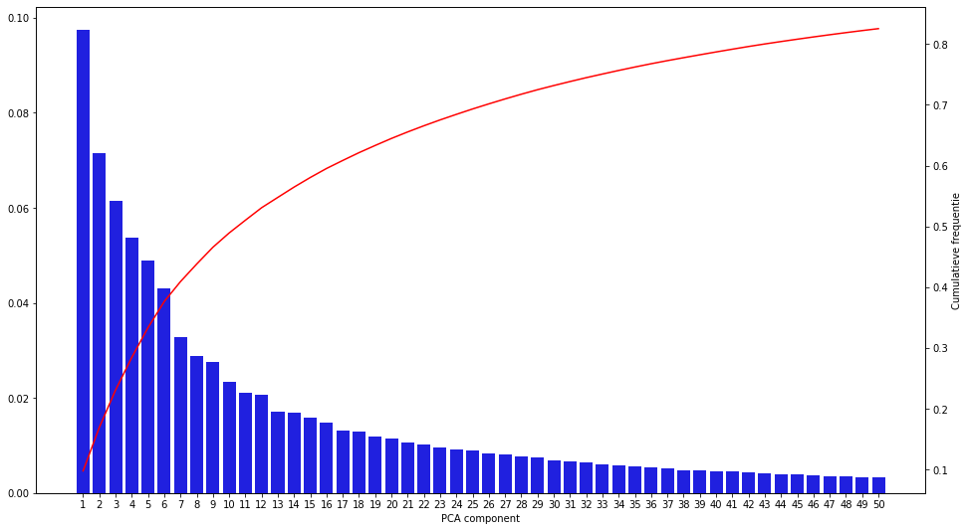
Principal component analysis
Determining a good number of principal components
We can plot the explained variance ratio of each PC
We can also plot the cumulative sum of this EVR.
Based on this, we can determine a good cutoff

